Slide 1
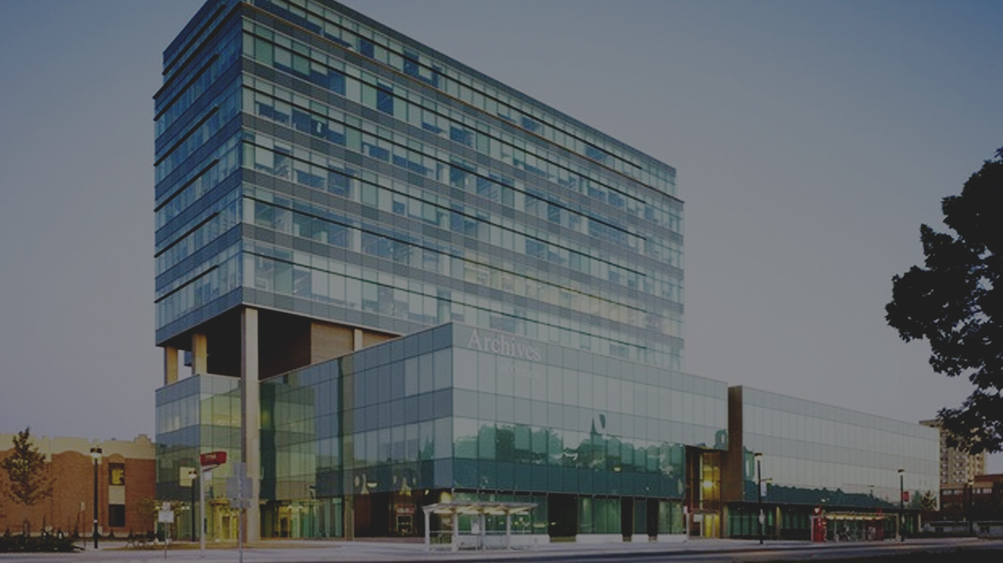


Notes:
Quick introduction of our names.

Slide 2
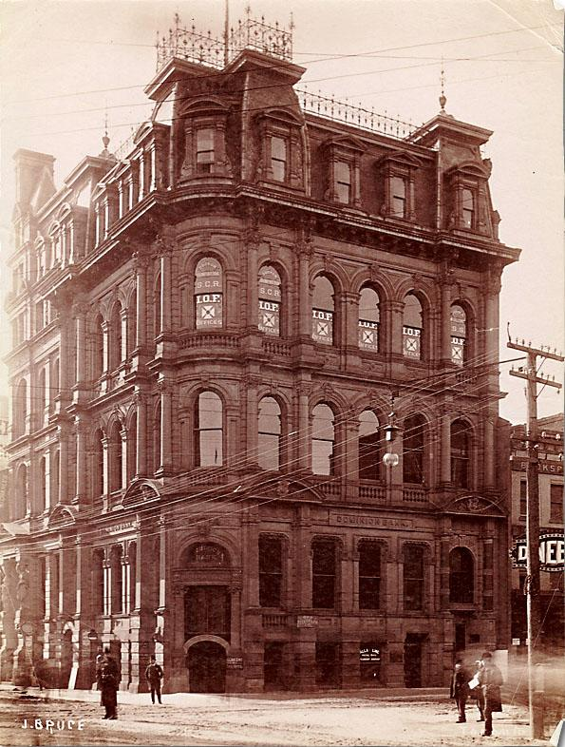
The Problem
The Solution
Audience Member(s)
Personas
Next Steps
Dominion Bank Building, S. W. Corner King and Yonge, Toronto, [ca. 1890]. Josiah Bruce. Black and white print. Reference Code: F 1125-1-0-0-98. Archives of Ontario, I0001862
Notes:
“Our Agenda”

Slide 3
The Problem
Accessibility - Not all artifacts are digitized
Traffic - How can we gain attention from new users? younger audience (19 - 45)
Community Value - How to combine resources to strengthen communities during Toronto’s improvement plans?
Notes:
Script:
When looking at the issues the Archive had, we outlined three key success factors: accessibility, traffic, and community values.
Accessibility:
We realized they had different modes of communication, online, in-person, phone, mail, interlibrary loan. Visiting the website, accessing records and visiting the building in-person are the most popular activities. Most archive customers are very computer-focused; over 4-in-5 have visited the website and turned to it as the first step when looking to access a record. However not everything is digitized, and there is room for easier navigation and search of information.
One of the findings they did in a survey was that there is frustration (Archives of Ontario 2017 Survey report) the building location is not easily accessible to the public. Some of this is a result from the hours of operation, making it very difficult to visit in an average work/school day.
Traffic:
We wanted to look at the key demographic who use the archive. We wanted to see how to get young people such as ourselves interested in the archive. We noticed that in the survey not a lot of young-adults, or youth had participated in comparison to those who were 45 - 65 years old. In a customer survey by the Archives of Ontario, 41% of the respondents were 45 - 65 years old. Only 4% were 19 - 24 years old, 27% were 25 - 44 years old. We wanted to see how we could drive these users?
Community Value:
The Archives of Ontario is an institution that provides information to preserving different sources of information. As we can see the city of Toronto is constantly changing from large scale improvement plans to the new post-secondary students that flock into the city. How could we combine the information and resource the archive has in relation to our identity, and communities here in Toronto?

Slide 4
We have launched a QR-Code Tour to learn the history of The Great Fire of Toronto. Explore the history of Toronto, and how the fire has shaped Front Street.
Notes:
Script (Elevator Pitch):
“We decided to look at how to drive more traffic to the physical facility and raise interest in the archives. Our goal is to bring the archives to life for a younger audience. A little over 100 years a fire would break out and lead to the majority of Front Street to disappear within nine hours. We have launched a QR-code tour to learn the history of The Great Fire of Toronto. And to learn how the fire has shaped Front Street to what it is now.”

Slide 5
The Solution
Three basic motions:
Scan: a QR code
Tap: a segment you are interested in
Swipe: to learn more
Notes:
Script:
We created a QR-code tour, where different spots in and around Front Street focus on the story about The Great Fire of Toronto. With three basic motions: scan the QR code, tap on which segment you are interested, and swipe to learn more.
What is not available in the presentation slide is the ability to use a sensor trigger. In one of the artifacts, it allows you to tilt your phone to scan the image–similar to AR.
For this, we wanted to reach an area that has a high traffic population–Front Street. From tourist, vendors, and regular commuters, we wanted to raise awareness on the archive by bringing the narrative to the user. We also wanted to explore the history of Toronto, and how the fire has now shaped Front Street to what it is now.
-

Slide 6
User Personas
University Student
City Planner
Audience
Business Employee
Tourist
Notes:
Script:
I will be going over briefly about our personas. Through our survey and user-testing, we were able to compile information on how our prototype can be scalable and useful for different community members. As you can see here: university student, a city planner, an employee in the financial district, and a tourist. In the next slide you will learn how we wish to further expand to reach these audience members.

Slide 7

Jared
Undergraduate student in RTA New Media
Age: 20 years old
Career: Part-time job as a barista
Gender: Male
Hobbies: Recording and making music, cooking, gallery hopping
Lifestyle
Goals
Commuter from Parkdale
Most likely to use mobile device to make purchases and communicate
Heavy Instagram & Twitter users
To travel domestically and abroad to learn about music culture
To be a part time musician
To be a journalist who writes about popular culture & music
Generation Z
In a 2011 census by Statistics Canada–about 7.3 million people (22% of Canada’s population) are Generation Z (Statistics Canada, 2011). Gen Z are now replacing millennials in the workplace.

Slide 8
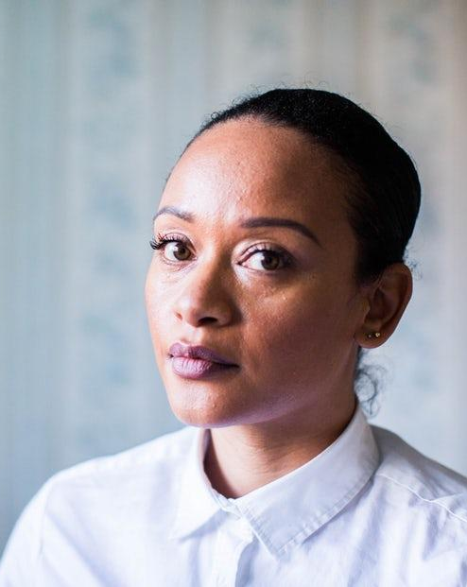
Casey
City of Toronto Urban Planner in the Parks Department
Age: 28 years old
Career: Approx. 55K/year
Gender: Female
Hobbies: Cyclist, volunteers at a community garden, camping
Lifestyle
Goals
Lives North of The Annex
Owns a cat and lives in an apartment
Visits the local library and reads The NYT, New Yorker, and graphic novels
Focused on developing a network
Saving money for a car
Working on a mentorship program for young females in urban planning and architecture
Millennials
1 in four millenials have actively engaged in a cause of in the past year, mostly involved in social justice, the environment, politics, and health care. They tend to get involved through online channels, but also seek to participate in person (The Counselling Foundation of Canada, 2017).

Slide 9

Karen
Financial Planner at King St. Firm
Age: 42 years old
Career: Approx. 75K/year
Gender: Female
Hobbies: Volunteering at her children’s school, reading fiction, experimental cooking
Lifestyle
Commutes from the suburbs outside of Toronto’s downtown core
Homeowner with middle-class living
Married with 2 young children
Goals
Move up within her firm
Raising a healthy and happy family
Retire early to pursue more volunteer work and take care of future grandchildren
Generation X
As children to the baby boomer generation, generation X were influenced by the changes made by their parents, including increased number of females in the work force and technological advancements (Statistics Canada, 2011).

Slide 10

Brandon
MSc Advanced Engineering from University of Leeds
Age: 24
Career: Researcher (Master-Candidate)
Gender: Male
Hobbies: Traveling, photography, baseball
Lifestyle
Goals
Get a successful job working for SpaceX
Find a career that is flexible to encourage travelling abroad and working
Enjoys reading science-fiction novels and playing board games
Loves to listen to podcast; Serial, The Ringer, and Hypebeast Radio
Millennials
Tourism agencies are starting to target the Millennial generation of travellers who seek experiences (Marandola & Northcott, 2016). Millennial families are driving the growth in travelling, with a combined 36.9 million vacations within 2017 (Newsdesk, 2017).

Slide 11

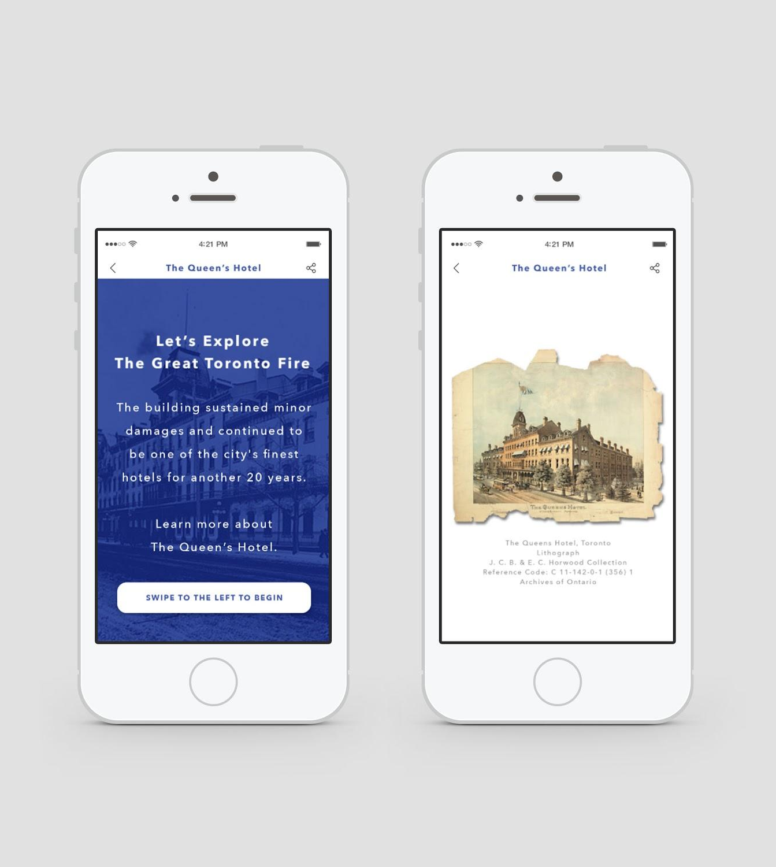
Next Steps
Prototype
The Narrative
Additional Project
Connecting to other institutions
Walking Tours
Open source map
Notes:
Script:
Prototype: We want to be able to provide an audio narrative that can accompany the QR-code and string together the story. One of the biggest mysteries is how the fire got started, and we would love to insert tidbits of this information. As well as actual interviews, or audio from those associated with The Great Fire from accounts or readings of newspaper clippings.
Additional Projects include: collaborating with other institutions, creating physical walking tours people can sign up for (especially in line with events such as The Front Street Market and Nuit Blanche), and creating an open source map where people are able to upload their QR codes down and curate their community story. If someone from Parkdale had an interesting story about the murals they see on their commute, we would love to be able to work with individuals to create this open map of QR-codes.
Overall: we want the Archives of Ontario to take their material and incorporate it into themes of community building by pairing it with artist and capacity builders. We want to hear people’s stories, and open the floor for discussing our idea of discovery.

Slide 12
The Prototype
The Prototype
Download a QR Code scanner
Scan the QR following codes
Explore the prototype
Give us feedback

Slide 13
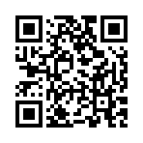
Explore the story
The Queen’s Hotel
https://share.protopie.io/BuHUBuz7mPL

Slide 14
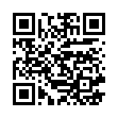
Explore the story
Bay Street
https://share.protopie.io/Z29m3LQsmwt

Slide 15
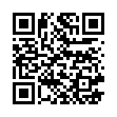
Explore the story
Kilgour’ Brother Building
https://share.protopie.io/Dd6wN4rvttE

Slide 16
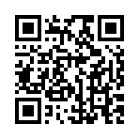
Explore the story
Yonge Street
https://share.protopie.io/FgwiZycevL4

Slide 17
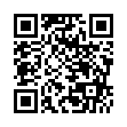
Explore the story
Union Station
https://share.protopie.io/JD7KQuUeKqY

Slide 18
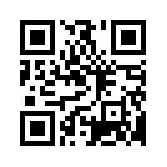
Give us feedback
I am a prototype designed by Ryerson University students that wants to connect YOU to the history of Ontario!
Using documents from the Archives and QR codes, I tell the story of the Great Toronto Fire of 1904.
I am a work in progress and want to improve. Can YOU help me?

Slide 19
References
Josiah Bruce. (Photographer). (n.d.). Dominion Bank Building, S.W. Corner King and
Yonge, Toronto [photography]. Toronto, ON: Archives of Ontario.
Marandola, S. & Northcott, A. (2016). Millennials are the new target market of
Canada’s tourism agencies. CBC News. Retrieved from
http://www.cbc.ca/news/canada/montreal/millennials-tourism-canada-1.3615959
Newsdesk. (2017). Stats: Millennials to Travel 35 Percent More in 2017, According to
MMGY. Travel Agent Central. Retrieved from
https://www.travelagentcentral.com/running-your-business/stats-millennials-to-travel-35-percent-more-2017-according-to-mmgy

Slide 20
References
Statistics Canada. (2011). Generation in Canada. [Catalogue number
98-311-X2011003]. Retrieved April 3, 2018 from
http://www12.statcan.gc.ca/census-recensement/2011/as-sa/98-311-x/98-3
11-x2011003_2-eng.pdf
The Counselling Foundation of Canada. (February 14 2017). Retrieved April 3, 2018
From
https://www.newswire.ca/news-releases/new-survey-reveals-the-diversity-of-canadas-millennial-generation-through-their-social-values-613786623.html

